Slide 1
Lecture-5
Array and Strings

Slide 2
We’ll Learn Today
Single & Multi-Dimensional Arrays
Passing arrays to a function
Sorting
Searching
Strings

Slide 3
Arrays
Name of array (Note that all elements of this array have the same name, c)
An array is a collection of variables of
a certain type, placed contiguously in
memory.
Array
  Group of consecutive memory locations
  Same name and type
To refer to an element, specify
  Array name
  Position number
Format:
    arrayname[ position number ]
  First element at position 0
  n element array named c:
    c[ 0 ], c[ 1 ]...c[ n – 1 ]
c[0]
-45
c[1]
6
c[2]
0
c[3]
72
c[4]
1543
c[5]
-89
c[6]
0
c[7]
62
c[8]
-3
c[9]
1
c[10]
6453
c[11]
78
Position number of the element within array c

Slide 4
Arrays (Cont’d)
Array elements are like normal variables
    c[ 0 ] = 3;
    printf( "%d", c[ 0 ] );
  Perform operations in subscript. If x equals 3
    c[ 5 - 2 ] == c[ 3 ] == c[ x ]
When defining arrays, specify
  Name
  Type of array
  Number of elements
    arrayType arrayName[ numberOfElements ];
  Examples:
    int c[ 10 ];
    float myArray[ 3284 ];
Defining multiple arrays of same type
  Format similar to regular variables
  Example:
    int b[ 100 ], x[ 27 ];

Slide 5
Arrays (Cont’d)
Initializers
    int n[ 5 ] = { 1, 2, 3, 4, 5 };
  If not enough initializers, rightmost elements become 0
      int n[ 5 ] = { 0 }
    All elements 0
  C arrays have no bounds checking
If size omitted, initializers determine it
    int n[ ] = { 1, 2, 3, 4, 5 };
  5 initializers, therefore 5 element array

Slide 6
Arrays (Cont’d)
Example:
main()
{ int marks[5], sum=0, i;
float avg;
for(i=0; i<5; i++)
{ printf(“Enter Marks of Subject %d:”,i+1);
scnaf(“%d”,&marks[i]);
sum = sum + marks[i];
}
avg = sum / 5;
printf(“\nTotal Marks:%d”,sum);
printf(“\nAverage Marks:%d”,avg);
getch();
}

Slide 7
Case Study: Computing Mean, Median and Mode Using Arrays
Mean – average
Median – number in middle of sorted list
  1, 2, 3, 4, 5
  3 is the median
Mode – number that occurs most often
  1, 1, 1, 2, 3, 3, 4, 5
  1 is the mode

Slide 8
Using Arrays to Summarize Survey Results
Forty students were asked to rate the quality of the food in the student cafeteria on a scale of 1 to 10 (1 means awful and 10 means excellent). Place the 40 responses in an integer array and summarize the results of the poll.

Slide 9
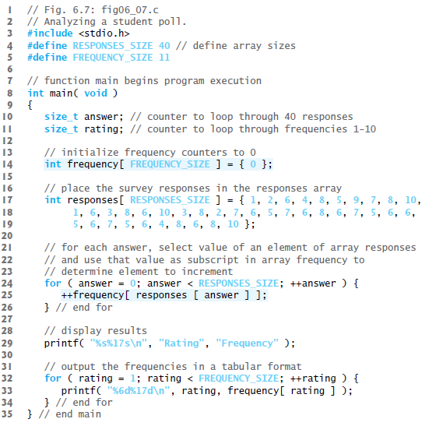

Slide 10
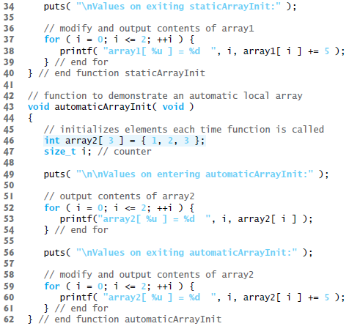
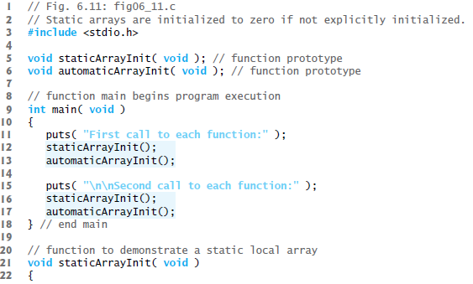
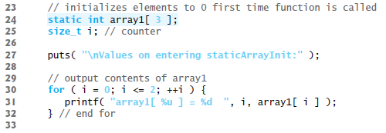
Static Local Arrays and Automatic Local Arrays

Slide 11
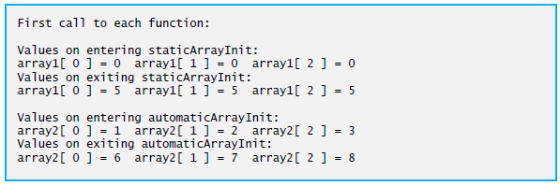
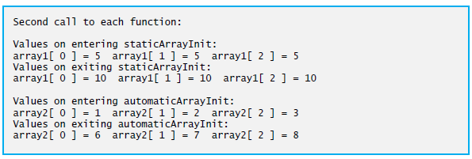
OUTPUT

Slide 12
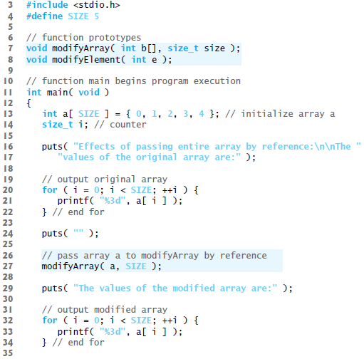
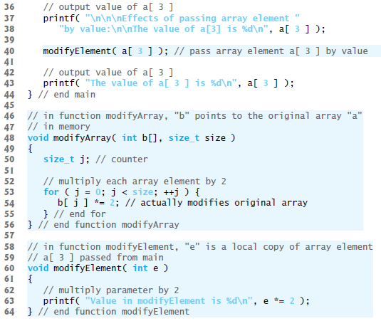
Passing arrays and individual array elements to functions.

Slide 13
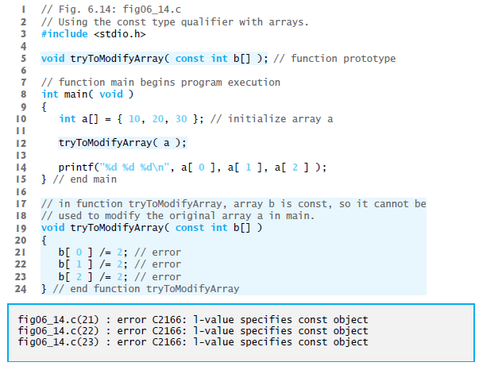
Using the const Qualifier with Array Parameters

Slide 14
Sorting Arrays
Sorting data
  Important computing application
  Virtually every organization must sort some data
Bubble sort (sinking sort)
  Several passes through the array
  Successive pairs of elements are compared
    If increasing order (or identical ), no change
    If decreasing order, elements exchanged
  Repeat
Example:
  original: 3 4 2 6 7
  pass 1: 3 2 4 6 7
  pass 2: 2 3 4 6 7
  Small elements "bubble" to the top

Slide 15
Searching Arrays: Linear Searching
Search an array for a key value
Linear search
  Simple
  Compare each element of array with key value
  Useful for small and unsorted arrays

Slide 16
Searching Arrays:Binary Searching
Binary search
  For sorted arrays
  Compares middle element with key
    If equal, match found
    If key < middle, looks in first half of array
    If key > middle, looks in last half
    Repeat
  Very fast; at most n steps, where 2^{n} > number of elements
    30 element array takes at most 5 steps
      2⁵ > 30 so at most 5 steps

Slide 17
Multiple-Subscripted Arrays
Multiple subscripted arrays
  Tables with rows and columns (m by n array)
  Like matrices: specify row, then column
Column 0
Column 1
Column 2
Column 3
Row 0
a[ 0 ][ 0 ]
a[ 0 ][ 1 ]
a[ 0 ][ 2 ]
a[ 0 ][ 3 ]
Row 1
a[ 1 ][ 0 ]
a[ 1 ][ 1 ]
a[ 1 ][ 2 ]
a[ 1 ][ 3 ]
Row 2
a[ 2 ][ 0 ]
a[ 2 ][ 1 ]
a[ 2 ][ 2 ]
a[ 2 ][ 3 ]
Column subscript
Array name
Row subscript

Slide 18
Multiple-Subscripted Arrays (cont’d)
Initialization
  int b[ 2 ][ 2 ] = { { 1, 2 }, { 3, 4 } };
  Initializers grouped by row in braces
  If not enough, unspecified elements set to zero
    int b[ 2 ][ 2 ] = { { 1 }, { 3, 4 } };
Referencing elements
  Specify row, then column
    printf( "%d", b[ 0 ][ 1 ] );
1 2
3 4
1 0
3 4

Slide 19
Multiple-Subscripted Arrays (cont’d)
Example:
main()
{ int stud[4][2];
int i;
for( i =0; i<=3; i++)
{
printf(“\n Enter roll no. and marks”);
scanf( “%d %d“, &stud[i][0], &stud[i][1]);
}
for( i=0; i<=3; i++ )
printf( “ \n %d %d “, stud[i][0], stud[i][1]);
getch();
}

Slide 20
Multiple-Subscripted Arrays (cont’d)
Initializing 3-Dimentional Arrays:
int arr[3][2][4] =
{ { { 1, 2, 3, 4 },
{ 5, 6, 7, 8 }, },
{ { 8, 7, 6, 5 },
{ 0, 2, 1, 4 }, },
{ { 8, 6, 6, 1 },
{ 1, 3, 5, 7 }, }, };
This is an array of arrays of arrays.
We could say, value at
arr[1][1][3] => 1 is true.

Slide 21
Strings
Strings are the form of data used in programming languages for storing an manipulating text such as words, names, and sentences.
In C, a string is not a formal data type as it is in some languages (e.g., Pascal, BASIC, VB, etc).
String is an array of type char.
All strings must end with a null character, ‘\0’, which has a numerical value of 0.

Slide 22
String Variable
Example:
main()
{
char name[81];
printf(“ Enter your name: “);
scanf(“%s”,name);
printf(“Hello, %s. “,name);
getch();
}
Note:
Since a string name is an address, no address operator need precede it in a scanf() function.

Slide 23
The String I/O Functions
There are many C functions whose purpose is to manipulate strings. puts() and gets() are one of them.
Example:
main()
{ char name[20];
puts(“ Enter your name: “);
gets(name);
puts(“Hello, “);
puts(name);
getch();
}

Slide 24
Arrays of Strings
We can initialize an array of strings at declaration in the following manner:
char month[12][10] = {"January", "February", "March", "April“, "May", "June", "July", "August“, "September", "October", "November“, "December"};

Slide 25
Quiz 02
1st Column
Write a program to change the case of all the alphabets in an array of strings.
2nd Column
Write a program that counts the no. of upper and lower case letters in an array of strings

Slide 26
String Functions
The string functions provide the ability to manipulate string variables and literals. String functions behave similarly to the standard C language functions. The return values also follow the C language convention. Most of the commons are giving in next slides.

Slide 27
strcat
char *strcat(char *s1, const char *s2);
The function copies the string s2, including its terminating null character, to successive elements of the array of char that stores the string s1, beginning with the element that stores the terminating null character of s1. It returns s1.

Slide 28
strcmp
int strcmp(const char *s1, const char *s2);
The function compares successive elements from two strings, s1 and s2, until it finds elements that are not equal.
If all elements are equal, the function returns zero.
If the differing element from s1 is greater than the element from s2 (both taken as unsigned char), the function returns a positive number.
Otherwise, the function returns a negative number.

Slide 29
strlen
Declaration:
size_t strlen(const char *str);
Computes the length of the string str up to but not including the terminating null character.
Returns the number of characters in the string.

Slide 30
strncpy
Declaration:
char *strncpy(char *str1, const char *str2, size_t n);
Copies up to n characters from the string pointed to by str2 to str1. Copying stops when n characters are copied or the terminating null character in str2 is reached. If the null character is reached, the null characters are continually copied to str1 until n characters have been copied.
Returns the argument str1.

Slide 31
More on Strings……..
Assignments:
  strerror();
  strrchr();
  strchr();
  strspn();
  strpbrk();

Slide 32
Exercise
Write a C program to read through an array of any type. Write a C program to scan through this array to find a particular value.
Write a program to copy the contents of one array into another in the reverse order.
Write a program to pick up the largest number from any 5 row by 5 column matrix.
Write a program to add two 6 * 6 matrices.
Write a program to delete all vowels from a sentence. Assume that the sentence is not more than 80 characters long.

Slide 33
End of Lecture 5
Any Questions ?????

